Slide 1
Complete Installation Guide

Slide 2
File for Python 3.11.0 Installation Request
In the meantime, wait for approval and download the Python 3.11.0 exe
Download from: https://www.python.org/downloads/release/python-3110
The external IT side will need this exe onhand to help you install with Admin privileges.

Slide 3
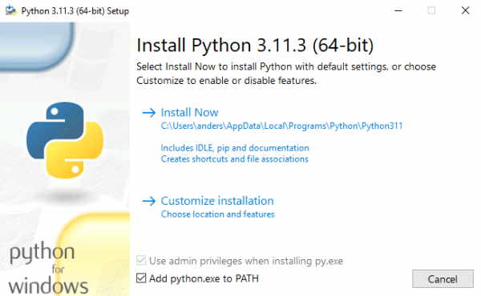
Installation Requirements, Python
Python 3.11.0: https://www.python.org/downloads/release/python-3110
When installer is launched, remember to tick “Add to Path”
RESTART the Laptop/Workstation before following the next slides

Slide 4
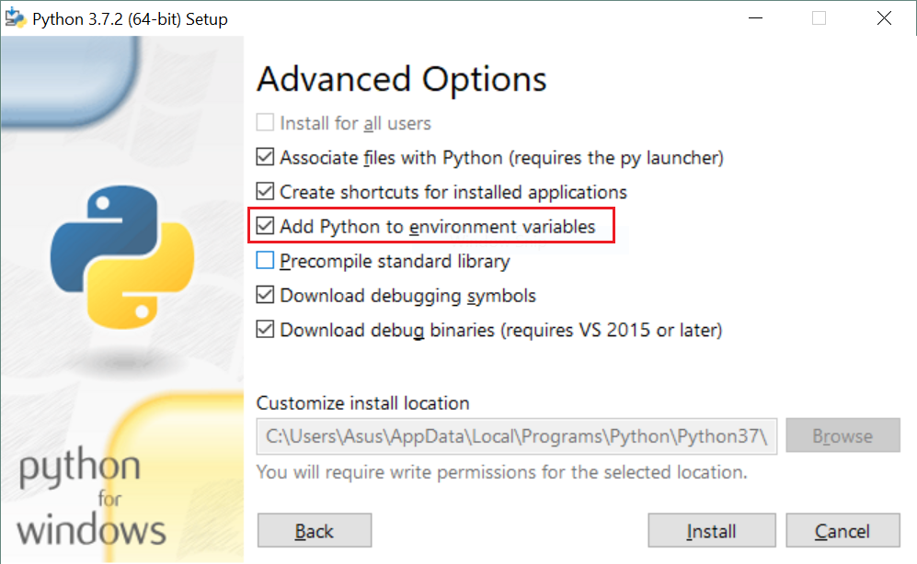
Installation Requirements, Python
2. Go to Customize Options, press Next and Add Python as an “Environment Variable” as well
RESTART the Laptop/Workstation before following the next slides

Slide 5
Getting the Project On Your Computer
Users will need to carry the remaining steps on their own OR get help from someone who is familiar with Python.
Open the project from this icon:

Slide 6

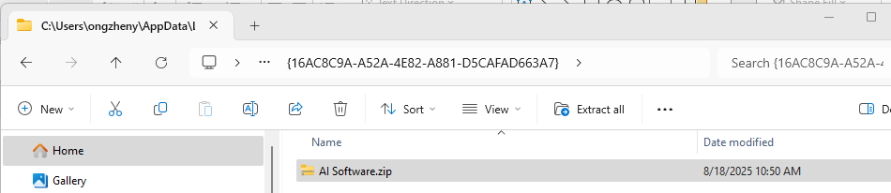
Getting the Project On Your Computer
2. You need to “Go Up One Level” first
3. Copy the Zip folder to your local directory and unzip it to your desired location

Slide 7
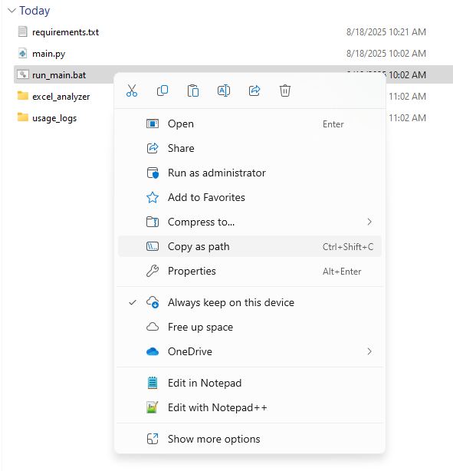
Adding a shortcut to your desktop
1. Find the bat file from the unzipped folder. Right click and “Copy as path”

Slide 8
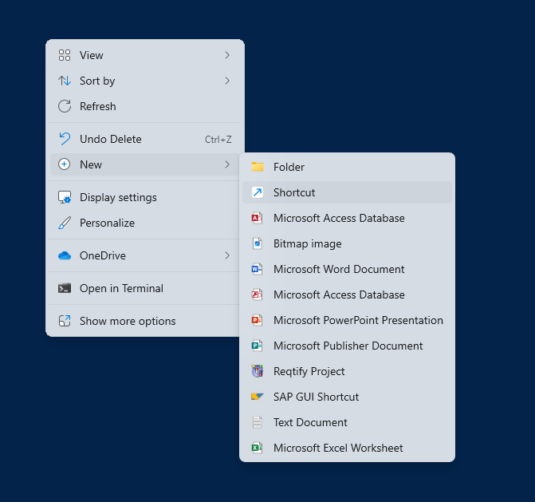
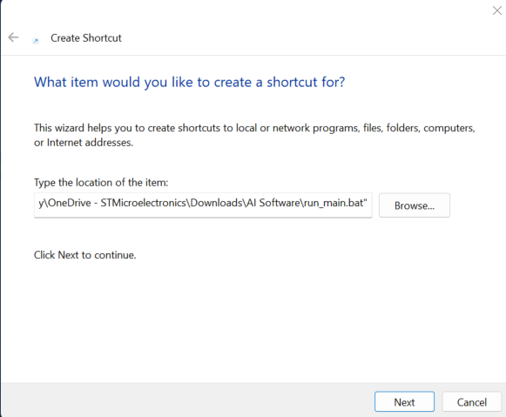
Adding a shortcut to your desktop
2. Go to your Desktop and right click, “New”, “Shortcut”, paste the path.
3. After pressing next, change the shortcut name to “AI Software” before finishing. Change the icon as necessary.

Slide 9
Adding a shortcut to your taskbar
1. In the folder, rename the .bat extension to .exe
2. Drag the .exe to the taskbar
3. In the folder, rename the exe file back to .bat
4. Shift + Right click on the taskbar icon (for the exe) and choose "Properties“
Continued in next slide

Slide 10
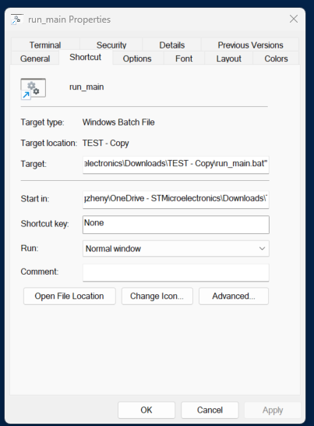
Adding a shortcut to your taskbar
5. Change the Target reference from .exe to .bat and change the icon as needed

Slide 11
Installing the required Libraries
1. Go to the unzipped folder and copy as path
2. Open the command prompt, type “cd” and on the same line paste the copied path
3. Then copy and enter this command:
pip install -r requirements.txt
After the requirements are installed, you can use the desktop or taskbar shortcuts you created to launch and use the software.

Slide 12
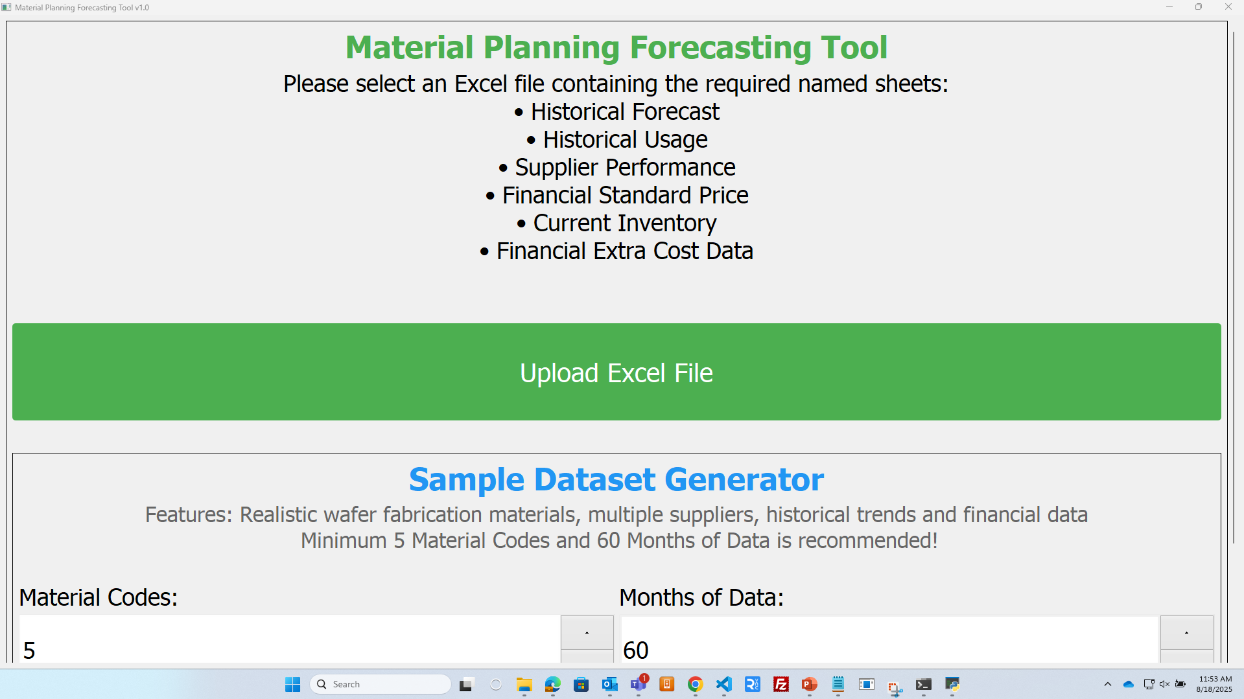
Testing the Software
If you did everything correctly, you should now be able to use the Software
IF SOMETHING IS NOT WORKING CORRECTLY, YOU SHOULD FOLLOW THE DEBUG GUIDE IN THE NEXT SLIDES

Slide 13
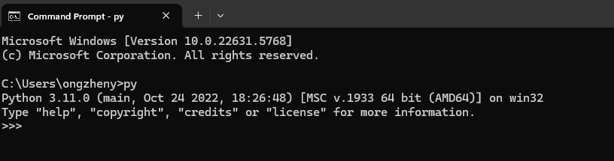
Installation Debug Steps
1. Check if Python 3.11.0 is installed correctly
Open the Command Prompt, enter “py”. It should show Python 3.11.0 version details

Slide 14
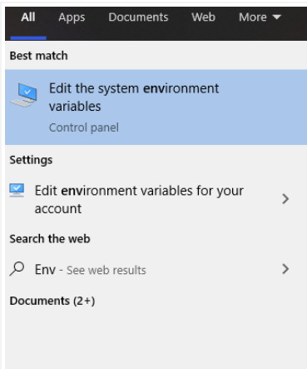
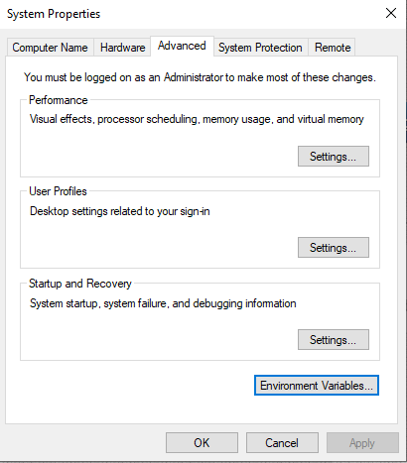
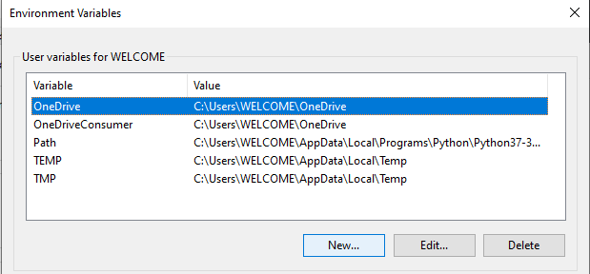
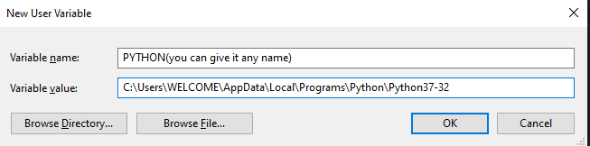
Installation Debug Steps
2. Check if Python was correctly added as “Path” under Environment Variables

Slide 15
Installation Debug Steps
3. If Python was not added as “Path” under Environment Variables, do these
Find the python.exe from your local drive, it should look be under something like:
C:\Users\<USER>\AppData\Local\Programs\Python
Right click the exe and “Copy as Path”. Go to Environment Variables, double click on Path, click on New and paste add the exe path

Slide 16
Installation Debug Steps
4. Check Library Versions. Double Click the Text Document, copy and enter everything into the Command Prompt.
It must show all are installed correctly. Otherwise, try the same steps in slide 11 again

